Slide 1
WELCOME

Slide 2
MEDICINE STORE MANAGEMENT APPLICATION
MEMBERS OF THE GROUP :
BINIT MONDAL
MANISHA SARKAR
PRASHASTI SINGH
RAJIT BASU
RIYA SHEKHAR
SULOCHANA ROY

Slide 3
CONTENTS
Introduction
Project objectives
Functional requirements
Basic features of the project
Resources required
Future scope of improvement
Acknowledgement

Slide 4
INTRODUCTION
It is well organized Software system for a medicine store.
This system enables to manage & record the activities of whole medicine store of multi-facility skills only.

Slide 5
OBJECTIVE
To assist the medicine shop keeper & administrators in capturing the effort spent on their respective working areas.
Administrators can monitor the medicine shop’s activity right from their own desktop.
The system generates a number of types of reports that can be then used for various managerial & administrative purposes.
Helps in keeping track of all the medical agency like login/logout time, security related activities etc.

Slide 6
FUNCTIONAL REQUIREMENTS
The project must request username & password for access to data, only after authentication will allow access to the system.
The software must allow input of products data from administrator & secured access.
The project must require high levels of error correction & input validation.
The project must identify the products by a unique numeric identifier derived from a function performed on product id.

Slide 7

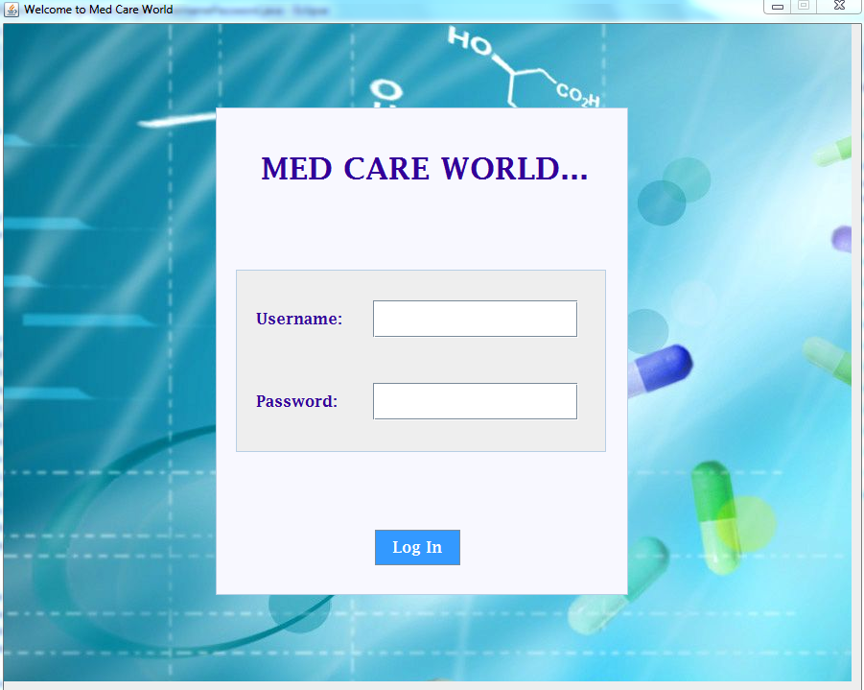
SCREENSHOTS

Slide 8
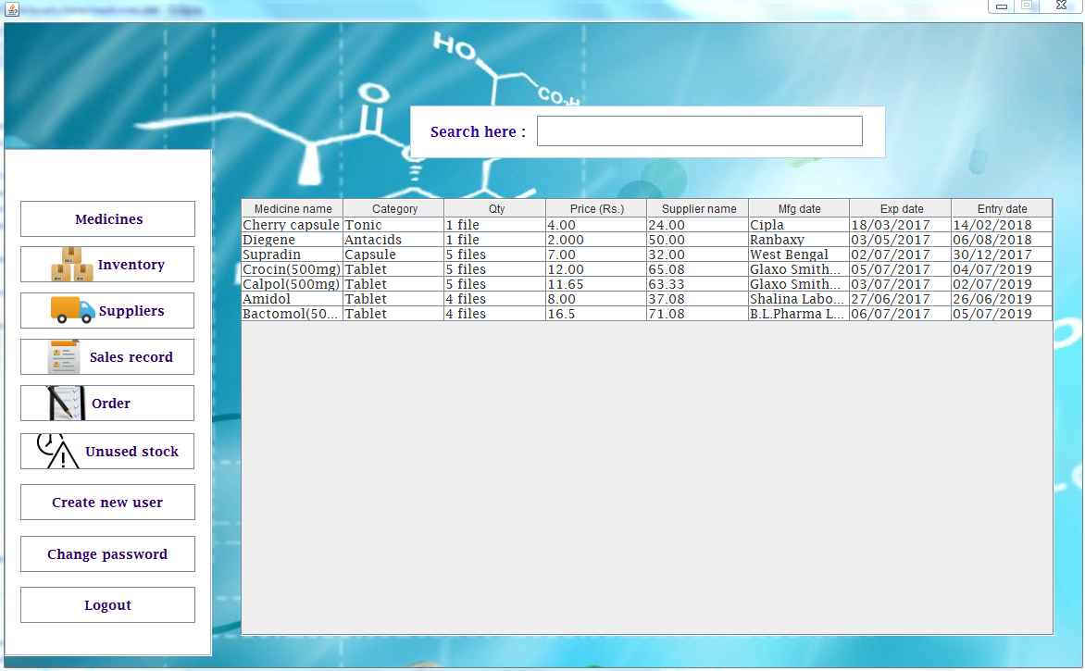
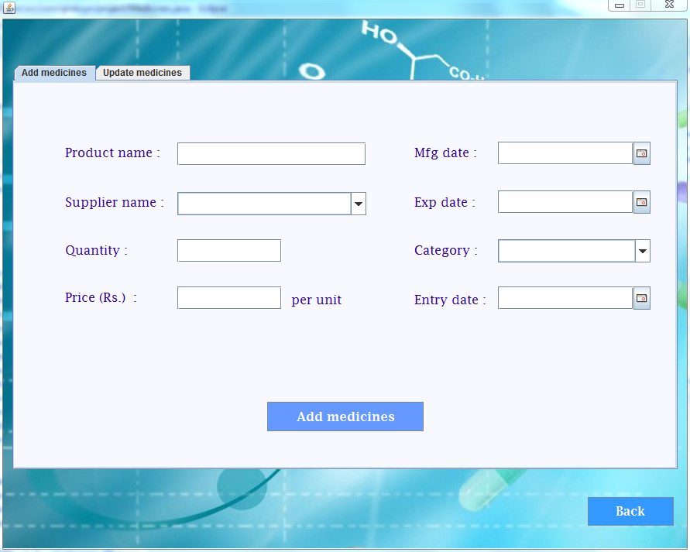

Slide 9
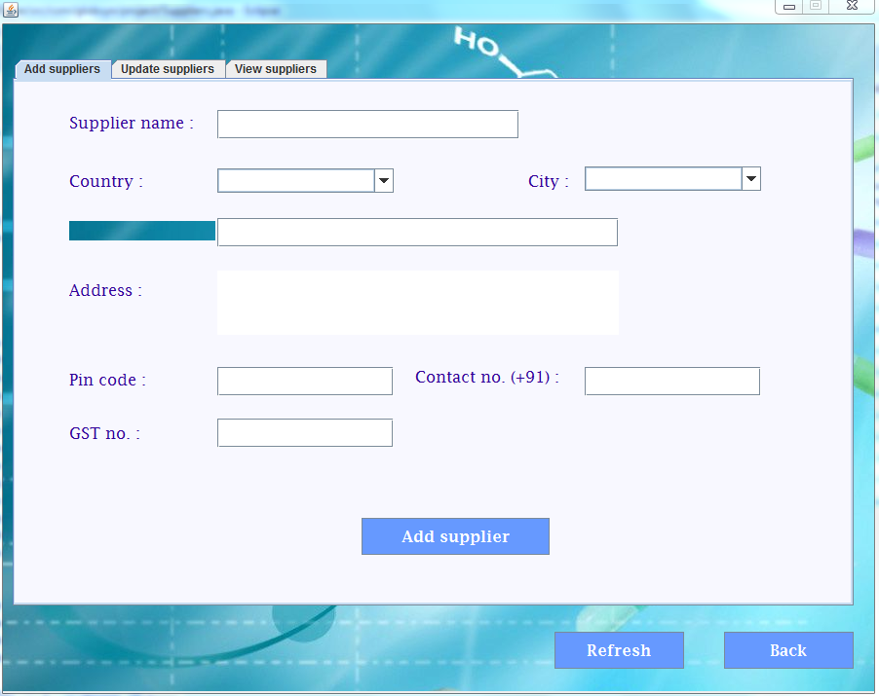
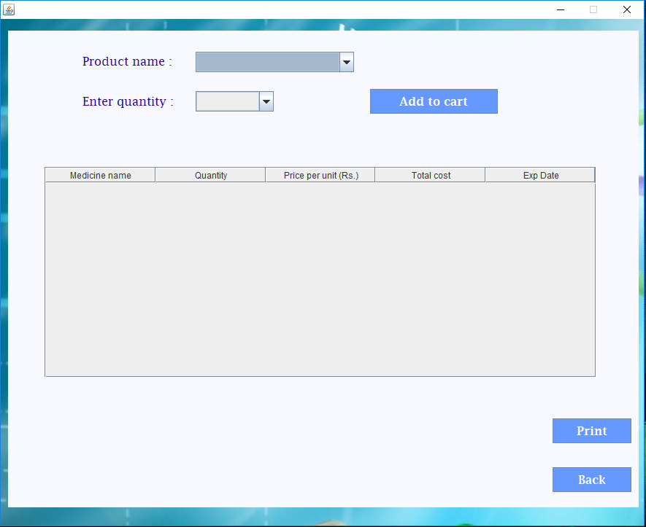

Slide 10
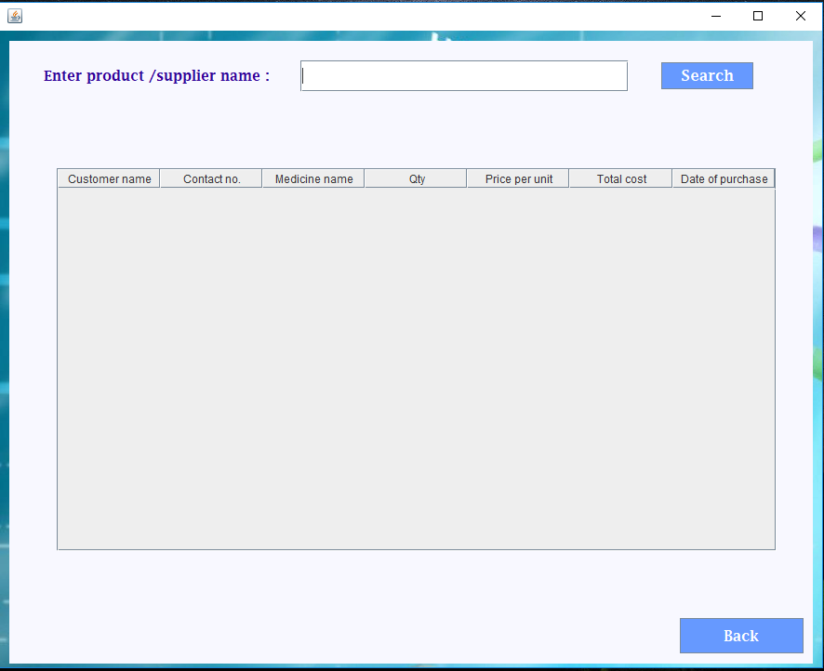
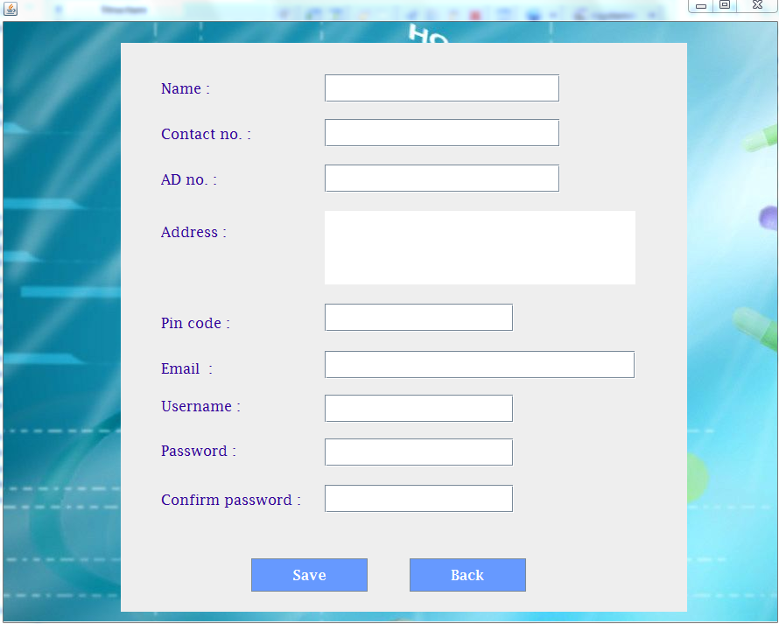

Slide 11
RESOURCES REQUIRED
HARDWARE REQUIREMENT
PROCESSOR : INTEL PENTIUM 4 & ABOVE
RAM : 256 MB RAM
HARD DISK : 2 GB
SOFTWARE REQUIREMENT
OS : 32 OR 64 BIT
JDK 1.8
ECLIPSE MARS 2.0

Slide 12
FUTURE SCOPE OF IMPROVEMENT
Better backup facility can be developed in the future.
In future we can also add various payment method like debit card , credit card.

Slide 13
ACKNOWLEDGEMENT
We take this oppourtunity to express profound gratitude and deep regards to our faculty Mr. Dayamay Halder for his guidance, monitoring and constant encouragement throughout the course of this project. His frequent blessings, help and cooperation shall carry us a long way in the journey of life on which we are about to embark. Also a heartiest thanks to team globsyn for organizing the entire training procedure.

Slide 14


